Slide 1

Youth Climate Action Day
October 23, 2021

Slide 2
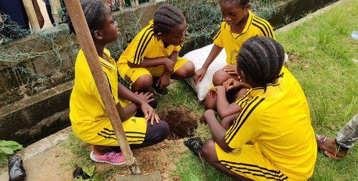
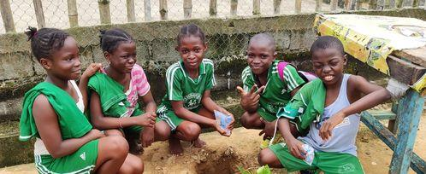
Cameroon, Douala
The Evangelical Church of Cameroon celebrated Youth Climate Action Day:
A soccer tournament was organized with pupils from primary schools.
Part of the celebrations was also a sensitization campaign on the dangers of deforestation and global warming.
The celebration continued with tree-planting: some 15 fruit-trees were planted by the pupils around the sport complex.

Slide 3
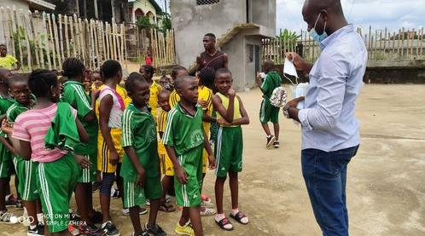
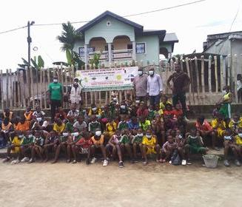
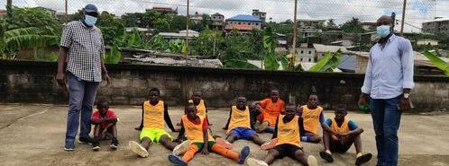
Cameroon, Douala

Slide 4
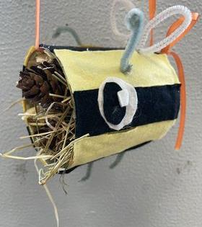
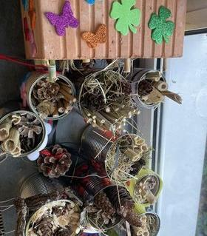

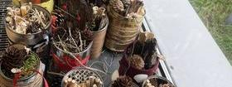
Germany, Bönen
Students of the Humboldt Realschule Bönen constructed insect hotels from recycled materials.

Slide 5
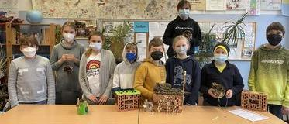
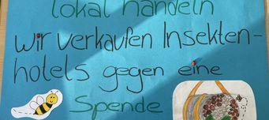
Germany, Bönen
On the parents' consultation day, the insect hotels were sold for a donation, and the proceeds were used to finance and set up two large insect hotels.
The project is also linked to the partnership with an Indonesian school: The students there also carry out sustainable projects and exchange ideas. Students and teachers will visit the partner school in Indonesia and deepen cooperation in sustainable projects.

Slide 6
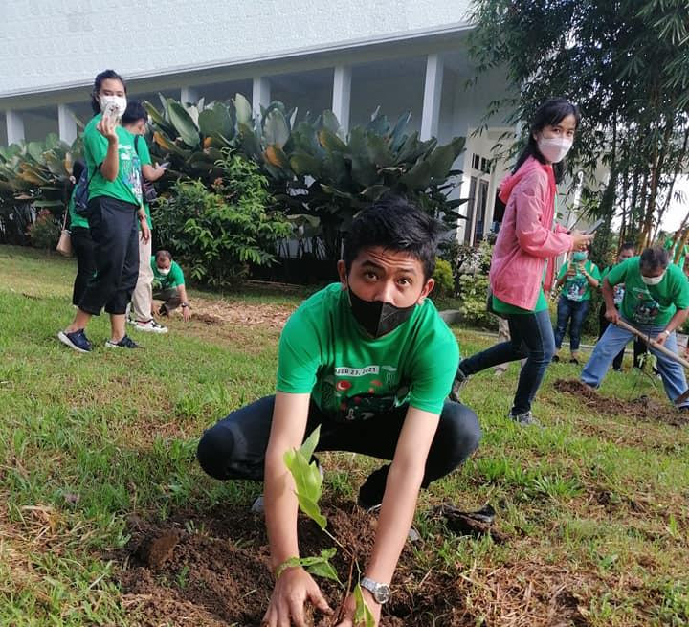
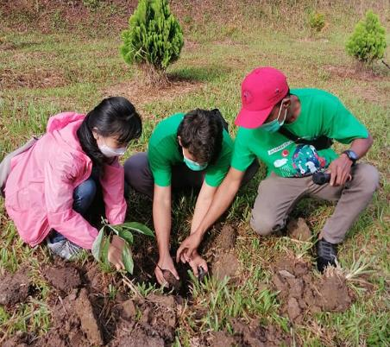
Indonesia, Pematang Siantar
Young people from various member churches and inter faith groups of United Evangelical Mission planted trees…

Slide 7
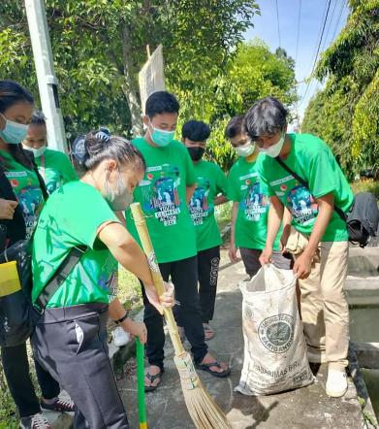
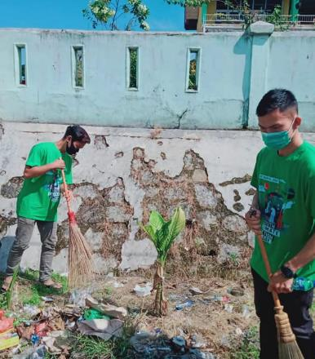
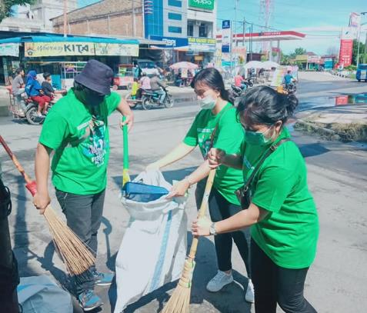
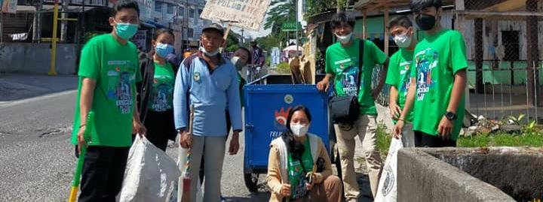
Indonesia, Pematang Siantar
…recollected waste…

Slide 8
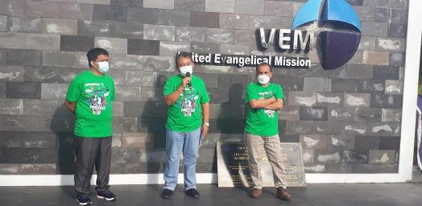
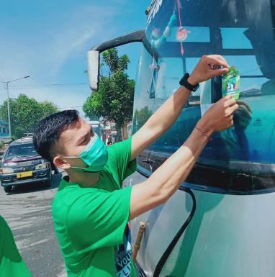
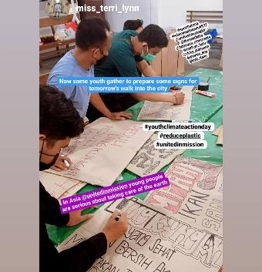
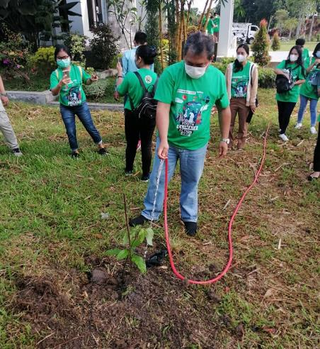
Indonesia, Pematang Siantar
… created awareness in the community about the importance of saving the earth and about using indigenous knowledge especially to protect the earth.

Slide 9
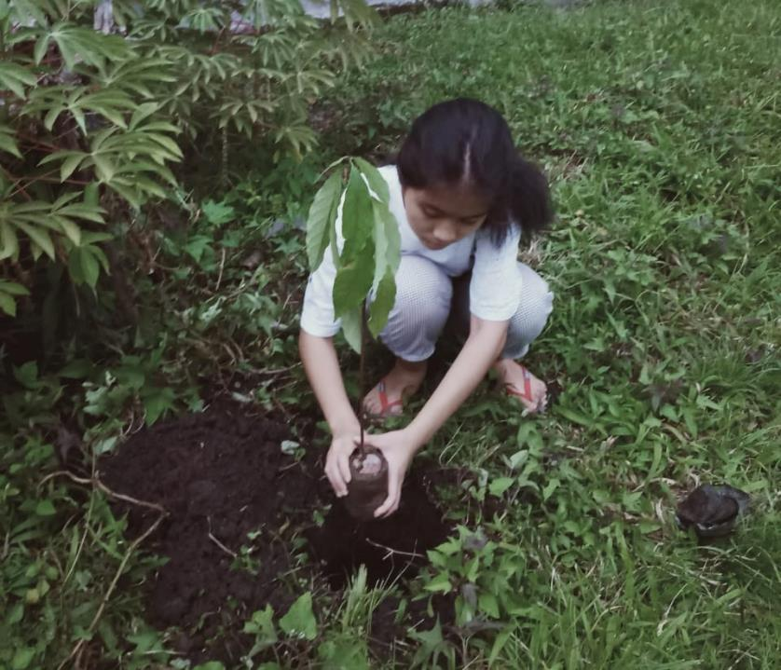
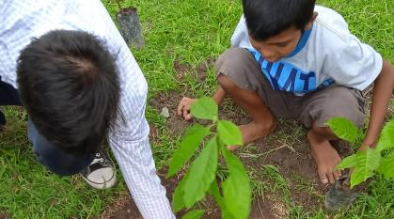
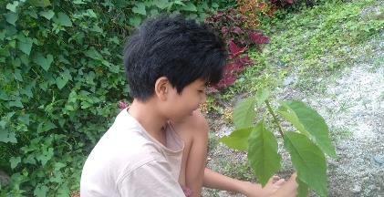
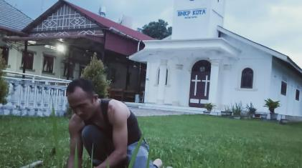

Slide 10
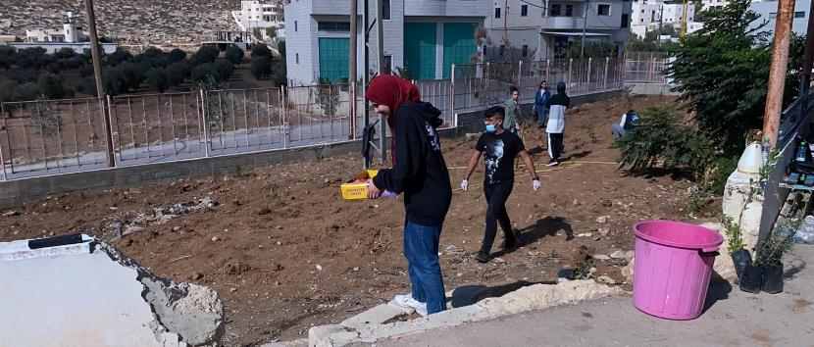
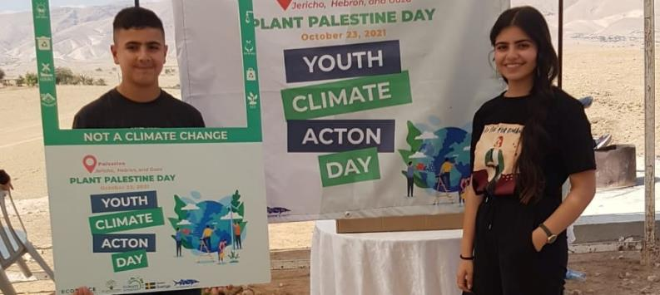
Palestine, Hebron and Jericho
150 Palestinian Youth Trustees from Good Water Neighbors Project joined Youth Climate Action Day, celebrating a “Plant Palestine Day”.
Together, they planted 260 seedlings of lemon, olive, acacia, ziziphus, and papaya trees at Kurza Secondary School for Girls in Hebron, Abasan Municipality Street, and Al-Awsaj village north of Jericho.
This activity was supported by the Swedish International Development Agency and Waterkeeper Alliance.

Slide 11
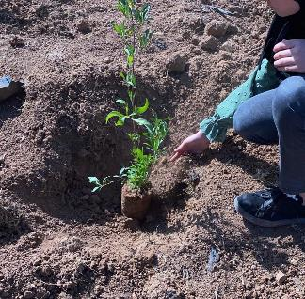
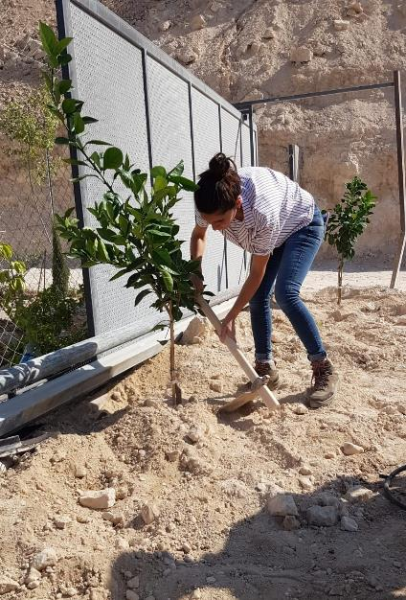
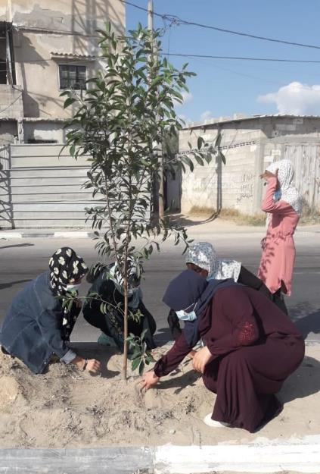
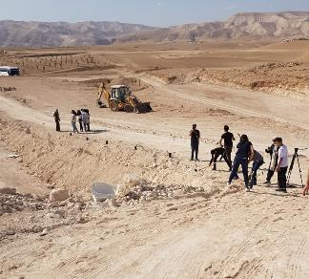

Slide 12
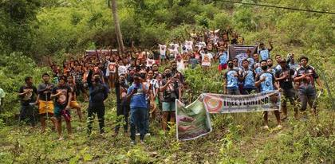
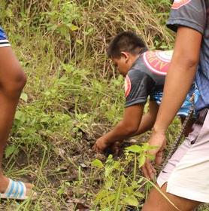
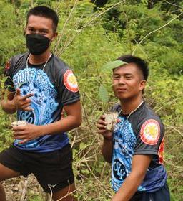
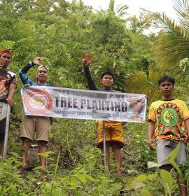
Philippines
In Philippines, the Alpha Kappa Rho contributed awareness in protecting ecosystems. Young people took action for climate by planting trees.

Slide 13
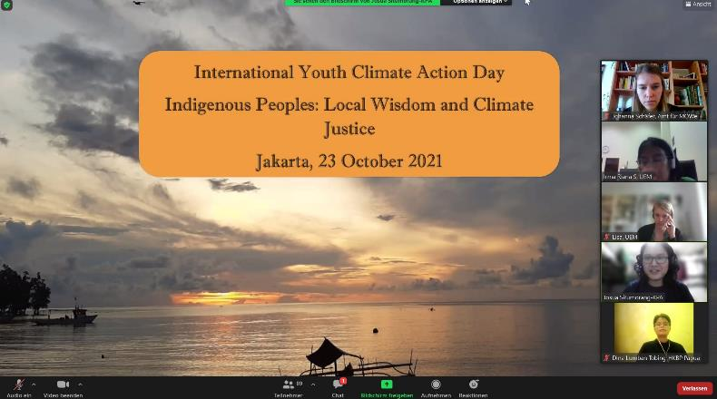
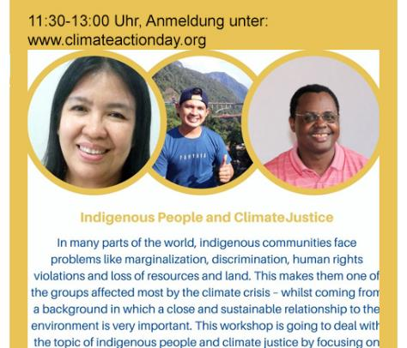
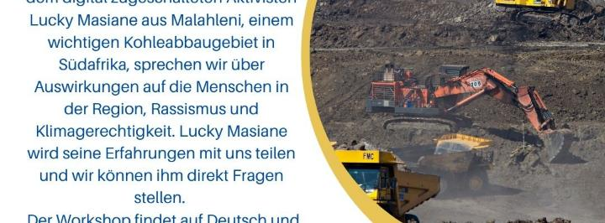
Online Workshops
More than 90 participants from five continents listening and discussing about Indigenous People and Climate Justice.
Discussing about consequences of carbon production in South Africa.

Slide 14

Youth Climate Action Day 2021
Thank you! ☺
Youth Climate Action Day is coordinated by:
Institute for Mission, Ecumenism and Global Responsibility Westphalia (MÖWE)
United Evangelical Mission (UEM)
One World Network NRW
BUNDJugend NRW
Landesjugendwerk der AWO NRW
Evangelical Youth of Westphalia

